Slide 1

Corporate law and economics (LL4489V/5489V/6489V) 2. the economic approach to corporate law I
LL4489V
Kenneth Khoo
kenneth.khoo@nus.edu.sg

Slide 2

THE FOUNDATIONS OF COMPANY LAW
What is Law and Economics?
Exchange and the Coase Theorem

Slide 3

What is law and economics?
Before we discuss Corporations and Corporate Law, we ought to address the methodological core of this course: “Law and Economics”.
“Law and Economics” is a methodological approach to the study of law that examines the effects of law on human behaviour through an economic perspective.
This distinguishes “Law and Economics” from a standard doctrinal course where the focus is on “what is the law is” from a judicial standpoint.
Even when the normative aspect of the law is considered in a doctrinal course, the pluralistic array of rationales often limits the discussion of “what the law should be”. Can you think of some conflicting rationales in Criminal Law?
The two “headers” deserve further discussion. Let’s review them in turn.

Slide 4

What is law and economics?
Examining the Effect of Law on Human Behaviour:
In a standard doctrinal law course, debates often focus on “what the law is”. Often, room for differing interpretations stem from the “open textured” nature of Law (Hart, 1960)
Example: “s157 CA: The business of a company is to be managed by, or under the direction or supervision of, the directors.”
Legal Q arises as to whether the term “is” implies a mandatory obligation on corporate stakeholders to vest decision-making powers in the board.
Economists often find these questions “boring”. Why?

Slide 5
What is law and economics?
Examining the Effect of Law on Human Behaviour:
Notice how the possible answers to these questions have little to no impact on many factors that social scientists or policymakers are interested in.
Using the aforementioned example, one might be interested in how board-friendly (corporate law) regimes might improve important measures such as shareholder returns, the level of creditor protection, the level of long-term investments made by the firm, or the extent to which board members would be willing to accept such terms.
More broadly, we might even extend this analysis to factors such as unemployment and economic growth.
All of the latter questions require an examination of how the law influences human behaviour.
Note: Causality runs the other way as well, but we will not focus on this channel (i.e., the study of “political economy”) in our course (except for where contracting tools are harnessed).
Problem: The law itself (and all of the tools associated with legal reasoning) does not provide us with a good way to address these questions. Why?

Slide 6
What is law and economics?
“Through an Economic Perspective”:
Evaluating the impact of law on human conduct thus requires a methodological perspective that is external/exogenous to law.
Traditionally, philosophy has assumed this role in law (recall “Introduction to Legal Theory”). But it has its limitations given the discipline’s aversion to assumptions.
What does this mean?
Other methodological perspectives include sociology and psychology.
Significant fields of “Law and Soci”, “Law and Psych”, especially in the U.S.
The methodological perspective we will adopt is the one advanced by economics. This has both pros and cons.

Slide 7
What is law and economics?
“Through an Economic Perspective”:
Pros:
Generalized theory of human behavior and conduct, based on the principle of utility maximization.
This allows us to answer a vast array of related questions without the need for context. Schwartz (2016) terms this the “transcontextual” nature of economic analysis.
Historical relationship with mathematics, statistics, and computing techniques: tremendous array of tools to address causal inference problems when empirical evidence is available.
Cons:
Assumption-laden: If our assumptions re utility maximization are wrong, so are our answers to these questions
Priors regarding economic assumptions face many objections. Efficiency is not the “be-all-and-end-all”.
Strong deontological objections, especially in fields in criminal law. What about corporate law? Other objections?

Slide 8
What is law and economics?
Ulen and Cooter (2016): “Beginning in the early 1960s... the new use of economics in the law asked such questions as, “Will private ownership of the electromagnetic spectrum encourage its efficient use?”; “What remedy for breach of contract will cause efficient reliance on promises?”; “Do businesses take too much or too little precaution when the law holds them strictly liable for injuries to consumers?”; and “Will harsher punishments deter violent crime?””
Notice how the last question (“Will harsher punishments deter violent crime?”) relates to what we have discussed so far – a question examining the effect of law on human conduct.
(contd): “Lawmakers often ask, “How will a sanction affect behavior?” For example, if punitive damages are imposed upon the maker of a defective product, what will happen to the safety and price of the product in the future? Or will the amount of crime decrease if third-time offenders are automatically imprisoned? Lawyers answered such questions in 1960 in much the same way as they had 2000 years earlier—by consulting intuition and any available facts. Economics provided a scientific theory to predict the effects of legal sanctions on behavior. To economists, sanctions look like prices, and presumably, people respond to these sanctions much as they respond to prices. People respond to higher prices by consuming less of the more expensive good; presumably, people also respond to more severe legal sanctions by doing less of the sanctioned activity. Economics has mathematically precise theories (price theory and game theory) and empirically sound methods (statistics and econometrics) for analyzing the effects of the implicit prices that laws attach to behavior.”

Slide 9
What is law and economics?
What is the impact of Law and Economics (L&E)?
Ulen and Cooter (2016): “Economics has changed the nature of legal scholarship, the common understanding of legal rules and institutions, and even the practice of law. As proof, consider these indicators of the impact of economics on law. By 1990 at least one economist was on the faculty of each of the top law schools in North America and some in Western Europe. Joint degree programs (a Ph.D. in economics and a J.D. in law) exist at many prominent universities. Law reviews publish many articles using the economic approach, and there are several journals devoted exclusively to the field. An exhaustive study found that articles using the economic approach are cited in the major American law journals more than articles using any other approach. Many law school courses in America now include at least a brief summary of the economic analysis of law in question. Many substantive law areas, such as corporation law, are often taught from a law-and-economics perspective... Summing this up, Professor Bruce Ackerman of the Yale Law School described the economic approach to law as “the most important development in legal scholarship of the twentieth century.””

Slide 10
What is law and economics?
Economic Analysis consists of three core “pillars”
Maximization: Each economic actor (this could relate to individuals or firms (more on firms later)) is assumed to maximize something subject to some constraints.
Consumers maximize utility, firms maximize profits, politicians maximize votes, etc. We will focus on utility and profit maximization in this course.
Equilibrium: When maximizing actors interact with each other, the social phenomenon that results is termed an equilibrium.
One can conceive of this as the “state of affairs” resulting from maximizing behavior.
Efficiency: This is the benchmark that economists use to determine whether a state of affairs (i.e., an equilibrium) is normatively desirable.
A situation is said to be pareto or allocatively efficient if it is impossible to change it so as to make at least one person better off without making another person worse off.
As each of the three “pillars” are fundamental, we will go through each in term.

Slide 11
What is law and economics?
Maximization: Each economic actor is assumed to maximize “something” subject to some constraints.
This is known by economists as the concept of constrained maximization.
In the vast majority of situations covered in this course, we will refer to the maximization problems of individuals, who will attempt to maximize their “utility”. In general, “utility” refers to “happiness” or “satisfaction”.
More precisely, individuals will attempt to behave in a way which reflects their preferences.
Example: If I prefer chocolate ice-cream over vanilla ice-cream, I will try to choose chocolate over vanilla at an ice-cream stall.
The maximization of utility by individuals is always constrained. Why must this be the case?
Example of constraints: Budget constraints, feasibility constraints, behavioral constraints of other agents
Classic example of constrained maximization: consumer who goes shopping at a supermarket chooses amongst the products available, subject to his/her budget constraint.
Q: Where do these “preferences” come from?

Slide 12
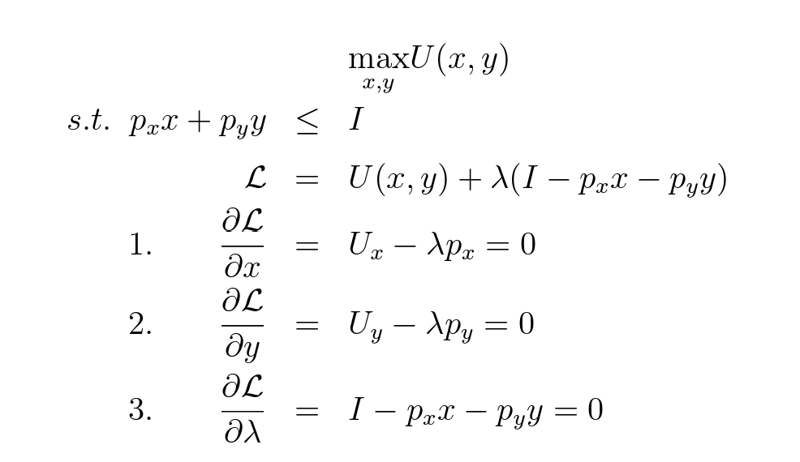
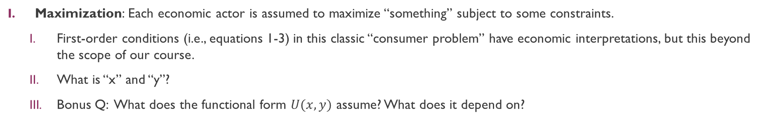
What is law and economics?
Maximization: Each economic actor is assumed to maximize “something” subject to some constraints.
First-order conditions (i.e., equations 1-3) in this classic “consumer problem” have economic interpretations, but this beyond the scope of our course.
What is “x” and “y”?
Bonus Q: What does the functional form $U(x,y)$ assume? What does it depend on?

Slide 13
What is law and economics?
Equilibrium: When maximizing actors interact with each other, the “state of affairs” that results is termed an equilibrium.
Economic agents interact with each other through their choices.
A rational, utility-maximizing individual will choose what is best for him/her (i.e., what maximizes his/her utility) given the set of alternatives and constraints that he/she faces.
The aggregate choices of an interacting set of economic agents give effect to the market price.
Thus, the concepts of “supply” and “demand” essentially stem from the aggregation of utility-maximizing choices across all individuals in a relevant situation.
“Aggregate Demand”: aggregation of utility-maximizing choices across all buyers. Likewise for sellers re supply.
At a market clearing price, aggregate supply = aggregate demand.
There are other game-theoretic concepts of equilibrium where utility-maximizing individuals will choose what is best for him/her given how he/she expect other individuals to behave.
Chess example.

Slide 14
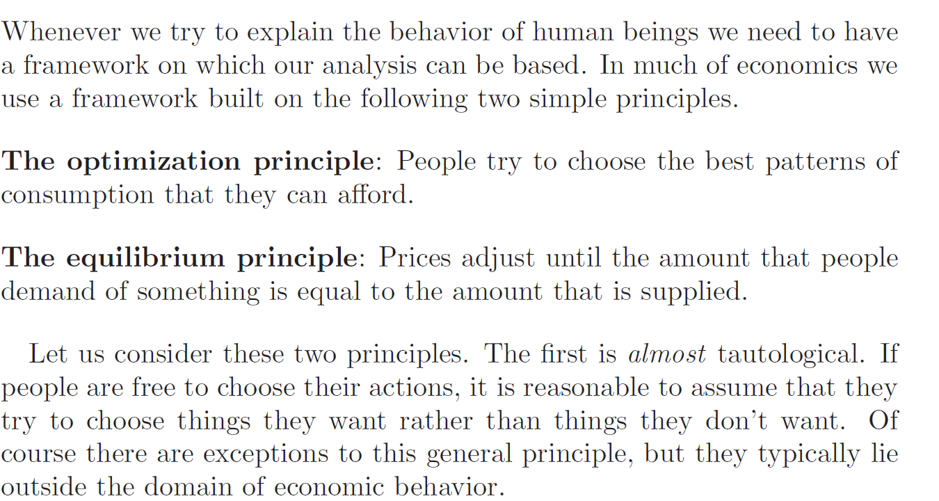
What is law and economics? (Varian (2010))

Slide 15
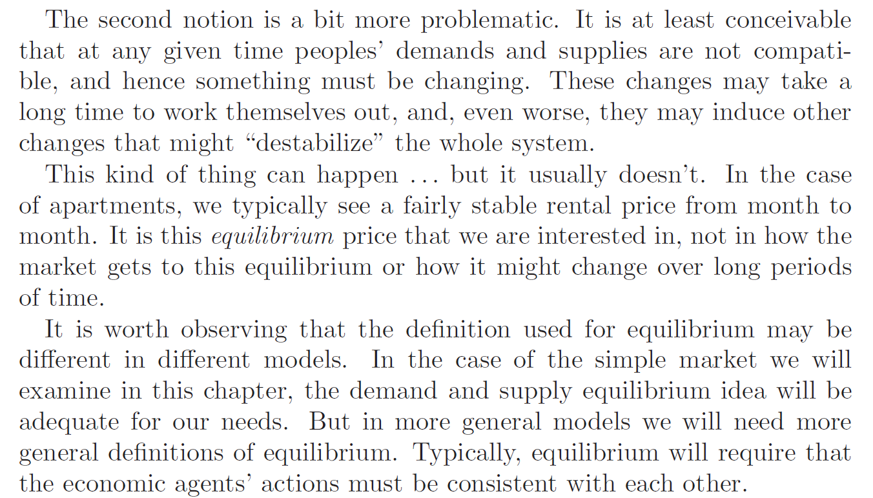
What is law and economics? (Varian (2010))

Slide 16
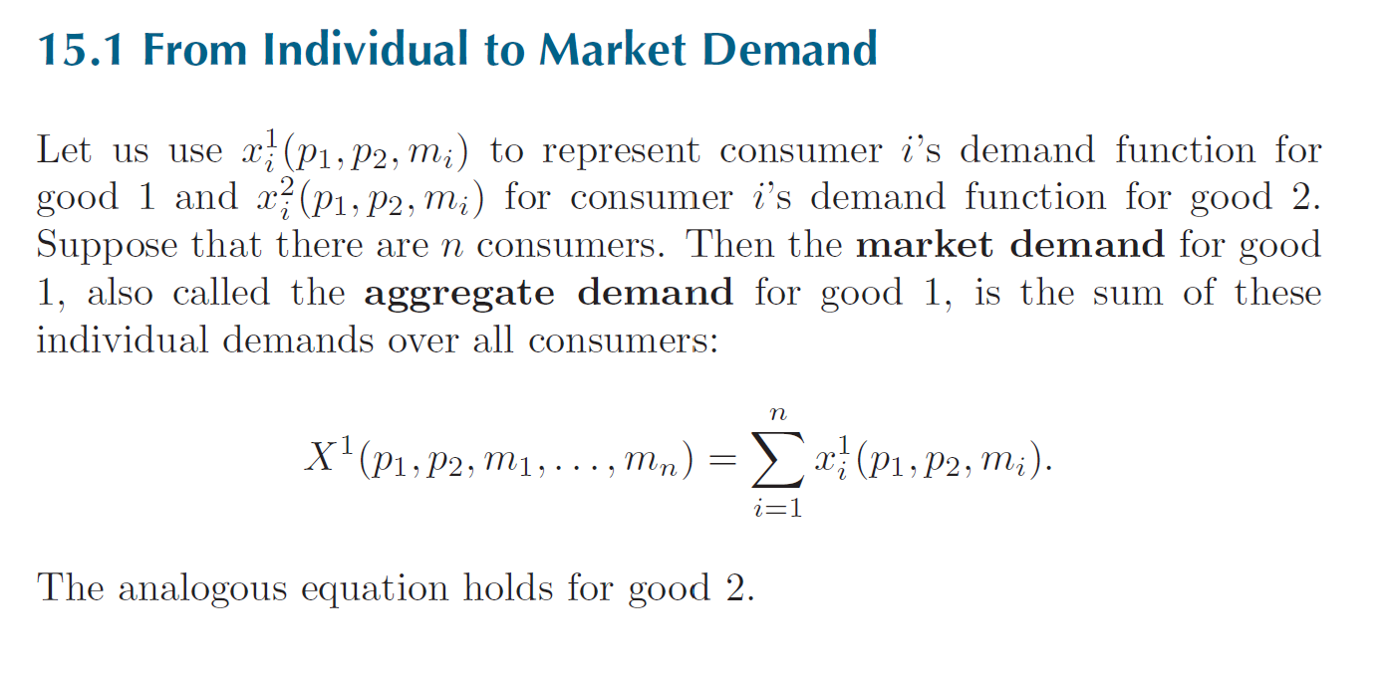
What is law and economics? (Varian (2010))

Slide 17
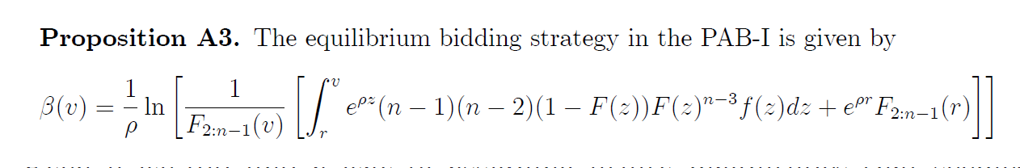
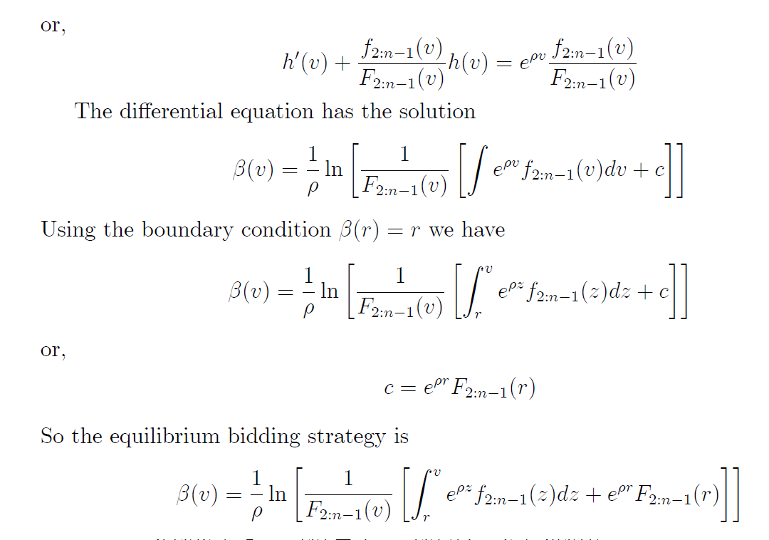
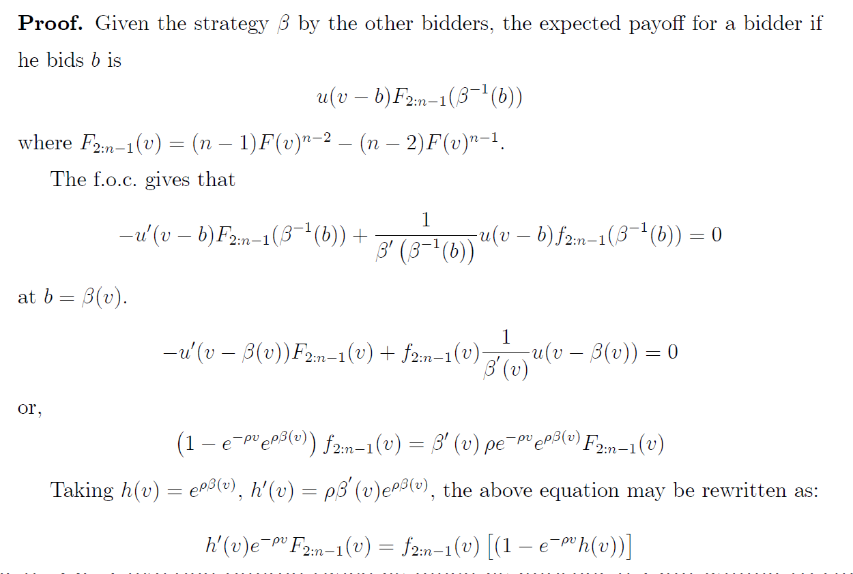
What is law and economics? (just for fun)

Slide 18
What is law and economics?
Efficiency: A benchmark that economists use to determine whether an equilibrium is normatively desirable.
Once we have determined equilibrium outcomes, it may be important (at least for most policymakers and academics) to determine whether that “state of affairs” is normatively desirable.
Economists often assess the attractiveness of a situation by gauging its efficiency.
Possibly the most important notion of economic efficiency relates to pareto efficiency.
Ulen and Cooter (2016): “A particular situation is said to be Pareto or allocatively efficient if it is impossible to change it so as to make at least one person better off (in his own estimation) without making another person worse off (again, in his own estimation).”
There are other important conceptions of efficiency used by economists (e.g., the notion of productive efficiency), but for the most part we won’t be referring to them in this course.
Intuition re pareto efficiency: “Cost-Benefit Analysis”, but in an ordinal setting.
What do we mean by cardinality vs ordinality? See https://en.wikipedia.org/wiki/Ordinal_utility vs https://en.wikipedia.org/wiki/Cardinal_utility
What about the cardinal setting?

Slide 19
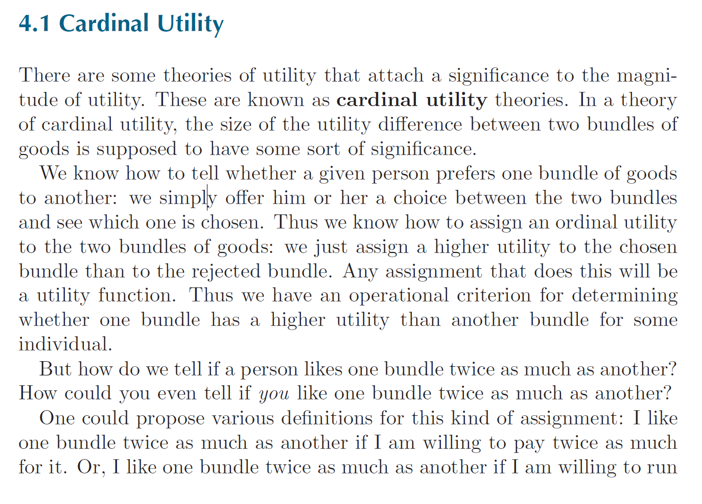
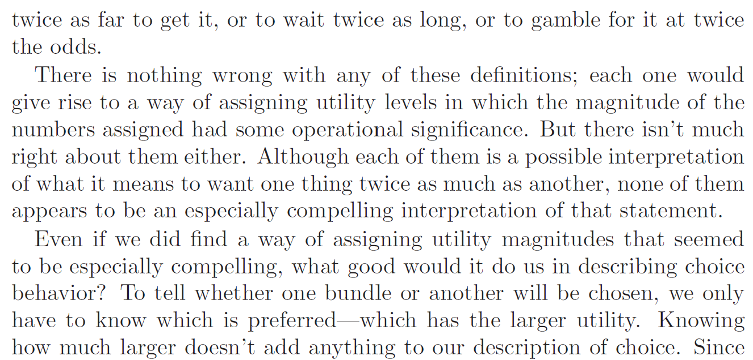
What is law and economics? (Varian (2010))

Slide 20
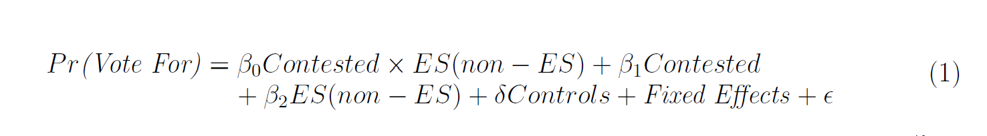
What is law and economics?
Up to this point, our discussion of economic analysis has been purely theoretical.
What about the “fabled” empirical analysis that holds such significance in modern economics?
As we will discuss in future seminars, the starting position of much of this analysis is that of statistics, not a framework of utility-maximization.
Empirical models which rely on foundations which are associated with utility-maximization are known as “structural models” (as opposed to “reduced-form” models). These models are beyond the scope of this course.

Slide 21
Q&A
See you guys on Tue.

